Slide 1

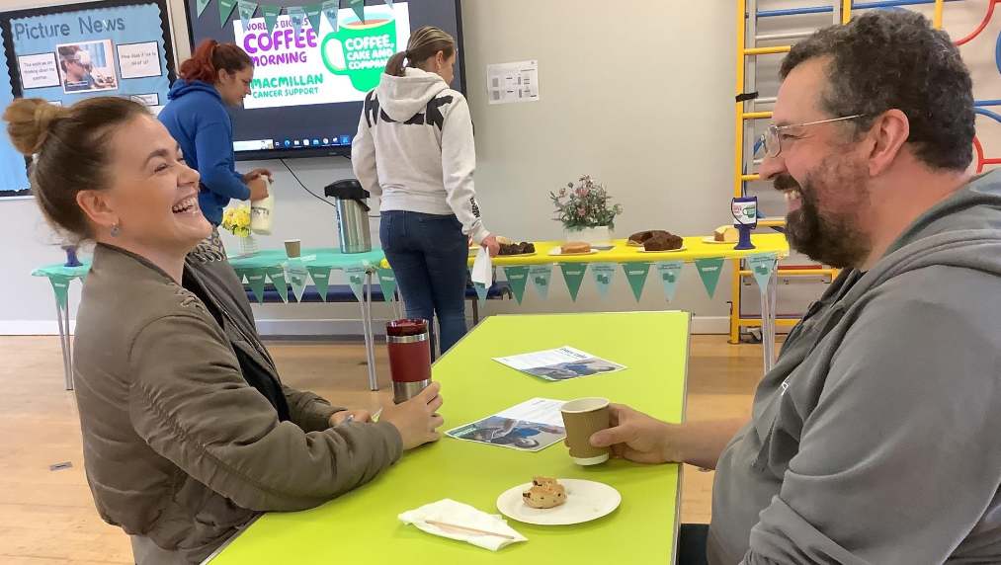
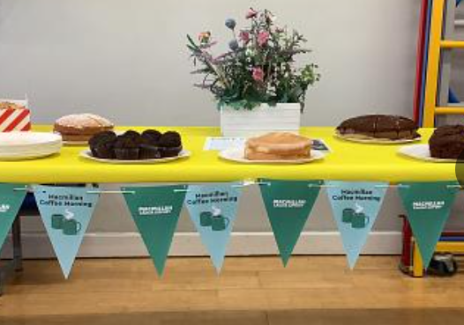

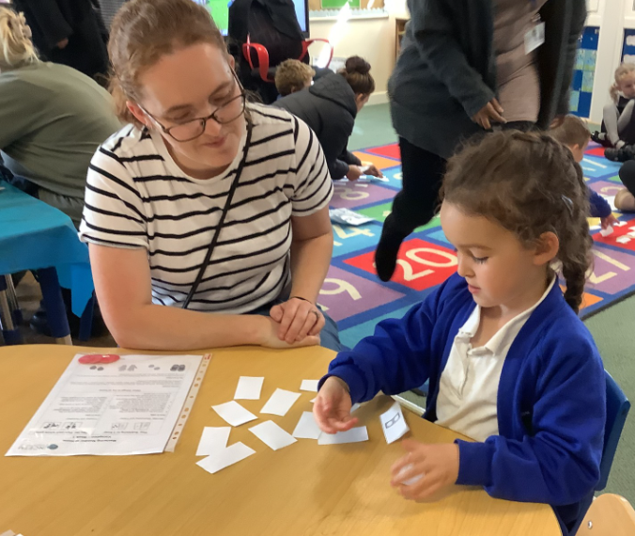
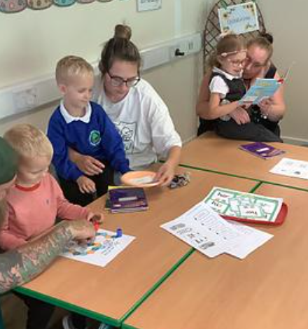

Moira Primary School
Newsletter 27-09-2024
It has been lovely to welcome so many of you into school for our maths drop ins and Macmillan Coffee Morning. I realise how tricky it is to attend things during the school day and we endeavor to share as much information as we can. Please do feel free to contact us if you have any further questions or comments.
Mrs Santy
Headteacher
Macmillan
Coffee
Morning
Thank you to everyone who was able to support our Macmillan Coffee Morning. Thank you for your cake and money donations. It was lovely to spend time with those of you who could make today ☺️
Parent Drop-in Sessions
Thank you to everyone who has been able to attend our KS1 drop in sessions for maths and phonics.
We really value your support and commitment to working together to help your child’s journey at school.
If you were unable to attend, further information has been shared on the class dojo pages.
PARKING
Can we please kindly ask that you do not park on Hazel Grove or Blackfordby Lane near the school. There have been numerous complaints from residents and a number of recent incidents where adults and children have nearly been hit. We ask that you park safely further away from school. Parking is available behind the shops.
Our school council will be monitoring and developing ideas to help encourage this safe parking so we hope you will support them to see a difference from Monday.
Parent Survey
Thank-you to those of you who took the time to complete our parent survey at the end of the summer term.
We are pleased to share that the results were positive and points raised, will be considered and addressed. If comments made were more personal to your own child, please feel free to contact us to discuss in more depth.
SEND support
As you are aware, we are going through a significant period of change and development. Mrs Hobbs and Mrs Santy are working hard behind the scenes to ensure that everything is in place for your children. If you have any concerns, Mrs Hobbs will be available during parents evening for you to speak to.
Many thanks for your patience and continued support.
Please visit Dojo & Tapestry for pictures of recent events and well-being. Visit us at www.moiraprimary.leics.sch.uk
LEARNING TOGETHER

Slide 2
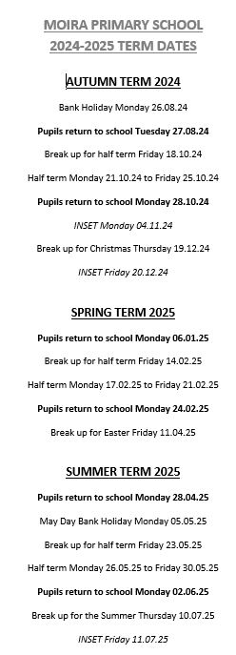

Diary Dates
DATES FOR YOUR DIARY:
SEPTEMBER
Saturday 28th New Starters 2025 Intake Open Day (11.30am – 1pm)
OCTOBER
Tuesday 1st Year 5/6 NWLSSP Tag Rugby (selected children)
Year 6 2.45pm Class Assembly
Wednesday 2nd Year 4 Swimming
All Parents online IT safety session (4-4.45)
Thursday 3rd Year 1 Reading Drop In (8.45am)
Years 1-6 Ashby RFC Rugby Taster sessions
Year 6 Ashby School Open Evening (5pm)
Saturday 5th Selected Wind in the Willows, Loughborough Town Hall
Monday 7th New Starters Opening evening (5pm)
Tuesday 8th All School photographs
5/6 NWLSSP Girls Football (selected children)
Wednesday 9th Year 4 Swimming
EYFS/Y1/Y2 Harvest Celebration (9.30am)
Thursday 10th Year 6 Reading Drop In (8.45am)
Monday 14th All Parents evening (3.30 – 6pm)
Wednesday 16th All Parents evening (3.30 – 6pm)
Year 4 Swimming (last session)
Friday 18th All Show Racism the Red Card Day
Half term: 21st October – 25th October
Monday 28th All Back to School
Wednesday 30th Year 5/6 Swimming lessons for non-swimmers
NOVEMBER
Monday 4th All Inset day – SCHOOL CLOSED
Wednesday 6th Year 5/6 Swimming lessons for non-swimmers
EYFS Stay and Play Session (2.30pm)
Friday 8th All Great Athletes Visit – Sponsored event and Paralympian visit
Thursday 7th Year 3 Reading Drop In (8.45am)
Saturday 9th All NWL Cross County – Sir John Moore
Monday 11th All Flu immunisations
Year 5/6 Remembrance Assembly (2.45pm)
Wednesday 13th Year 5/6 Swimming lessons for non-swimmers
All Book Fair in School (until 20th)
Thursday 14th Year 4 Reading Drop In (8.45am)
Friday 15th Year 5/6 Parliament Trip (details TBC)
Tuesday 19th All Meet & greet (head/assistant heads) (2.30pm)
Wednesday 20th Year 5/6 Swimming lessons for non-swimmers
Thursday 21st Year 2 Reading Drop In (8.45am)
Wednesday 27th Year 5/6 Swimming lessons for non-swimmers
Thursday 28th Year 5 Reading Drop In (8.45am)
DECEMBER
Friday 6th EYFS & KS1 Century Theatre Panto Trip
Tuesday 10th EYFS &Year 1 Christmas Performances (10am & 4pm)
Wednesday 11th Years 4,5,6 Christmas Performances (10am & 4pm)
Thursday 12th Years 2 & 3 Christmas Performances (10am & 4pm)
Tuesday 17th KS2 Loughborough Town Hall Panto Trip
Wednesday 18th Year 2 Christmas Journey (Ashby Methodist)
Thursday 19th All Break-up for Christmas
Friday 20th All Inset Day – SCHOOL CLOSED
JANUARY
Monday 6th All Back to School
If you have changed your email address, telephone number or moved house, don’t forget to let us know so our school records remain up-to-date!
LEARNING TOGETHER

